Slide 1
Go Above and Beyond!
Customize / Contribute / Extend

Slide 2
Who is this guy?
Sébastien (Seb) Julliand
Code for IBM i core team member
IBM Champion 2024
R&D Advisor / Tech Lead at ARCAD Software

Slide 3
Customize
Make the most out of it

Slide 4
Customize - Settings
Automatize UI
Open after copy/move
Refresh after operation
Clear diagnostics/errors/output
Default actions
Open mode
Drag’n’drop behavior

Slide 5
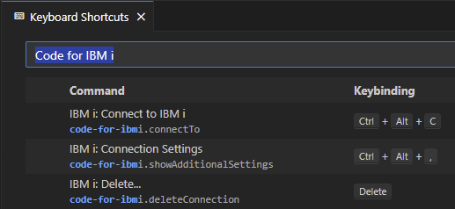
Customize - Keyboard shortcuts
Ctrl+K Ctrl+S
Filter on “Code for IBM i”

Slide 6
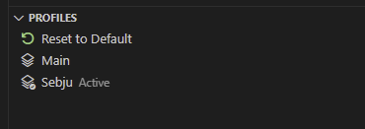
Customize - Profiles
Quickly switch between contexts
Object/IFS filters
Library list and Current library
Home directory
Custom variables

Slide 7
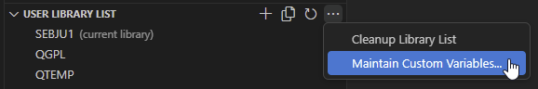
Customize - Variables
Define action variables
Saved in profiles

Slide 8
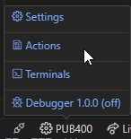
Customize - Actions
Run one or more commands
Supports variables (based on target’s type)
Member
Streamfile
Object
Workspace file
Supports custom prompts! (text and select inputs)
Can refresh target’s parent
Ctrl + e

Slide 9
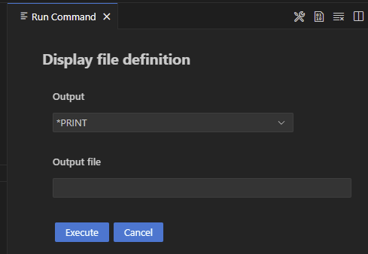
Customize - Actions custom prompt
Custom prompt example
Select: OUTPUT(${output|Output|*PRINT,*OUTFILE})
Text: OUTFILE(${outfile|Output file})

Slide 10
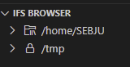
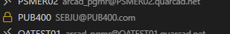
Customize - Protected modes
Prevents “mistakes” on sensitive LPARs
Different levels
Global
By path (QSYS and IFS)
Object filter

Slide 11
Contribute
Bring something to the table

Slide 12
Contribute - Discuss
https://github.com/orgs/codefori/discussions
Not for issues 😅
Ask for tips or help
Share ideas
Engage with the community

Slide 13
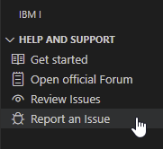
Contribute - Issues section
One Issues section per extensions
https://github.com/codefori/vscode-ibmi/issues
https://github.com/codefori/vscode-db2i/issues
…
Report issues
Use the Report action and complete the template!
Share👏🏻your👏🏻Code for IBM i👏🏻output
Request for enhancement

Slide 14
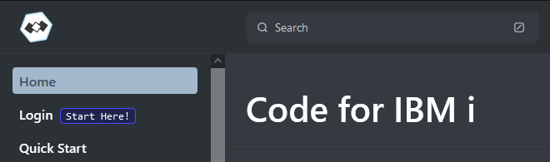
Contribute - Add/update documentation
https://github.com/codefori/docs
Every contribution is welcome

Slide 15
Contribute - Code!
Every contribution is welcome (again)
Start simple and small
Fork
Code
Create a Pull Request
“Good first issue”
Ask for help

Slide 16
Extend
Do what you want

Slide 17
Extend - Requirements
Node.js
VSCode 🤦🏻‍♂️
TypeScript notions
VS Code API https://code.visualstudio.com/api/
A small and simple first idea

Slide 18
Extend - Use a template
https://github.com/sebjulliand/vscode-extension-template/tree/code4i
Adds Code for i dependencies
Provides translation support, build, packaging
Provides debug task
Grabs reference to Code for i runtime API
Focus on coding!

Slide 19
Extend - Code for i exported API
Run SQL
Execute commands
CL
Shell
Do on events
Connected
Disconnected
Deploy location change
Deploy
Custom UI
Deployment API
General purpose tools
…

Slide 20
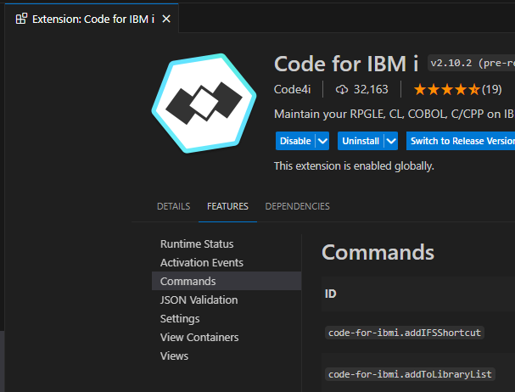
Extend - Code for i commands
Available to all
Extension -> Features -> Commands
Documentation needs an update 😓
Useful to refresh browsers
Prioritize the API when possible

Slide 21
Extend - View item contexts
connectionBrowser
server
ibmiDebugBrowser
debugJob_(server|service)(_on|_off|)
objectBrowser
filter(_library)(_readonly)
object.<type>(.<attribute>)(_library)(_readonly)
SPF(_readonly)
member(_readonly)
ifsBrowser
streamfile
directory(_protected)
shortcut(_protected)
libraryListView
currentLibrary
library
profilesView
resetProfile
profile
commandProfile

Slide 22
Extend - Simple example extension
https://github.com/sebjulliand/extend-codefori
Based on my template
Adds commands to palette
Run IBM i command
Open spooled file
Adds an action on *FILE
Adds an action on member

Slide 23
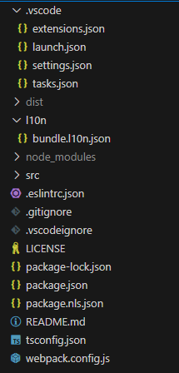
Extend - Components
Required extensions
Debug task
Source code localization
Source code
Contributions
Commands
Menu
TypeScript config
Transpilation config

Slide 24

Questions?
Don’t be shy!

Slide 25

Thank you !
Seb Julliand
sebjulliand@gmail.com
sjulliand@arcadsoftware.com
“Come find me and let’s have a chat!”

